Slide 1
9th Management meeting
Mutah University, Jordan
7th July, 2022
M. Sc. Alex Dekin
Leipzig University of Applied Sciences - HTWK

Slide 2
Work Package 2
Development(WP2): Establishing Business Network Bureau.
P leader HTWK
Number | Title | Coordination |  |  | Estimated Start/ End Date
 |  | Coordinator | Co- Coordinator | Other partners involved
WP2 | Development: Establishing Business Network Bureau. | HTWK | INT@E, MU & AHU | All | 1/1/2019 To 15/11/2020
2.1 Scoping and Market Needs Analysis
2.2 Purchasing equipment, Installation and preparation the Bureau
2.3 Trainings to study of experiences of European Partners
2

Slide 3
Work Package 2
Activities carried out to date to achieve project result
Activity N° | Activity Title | Start date | End date | Place | Description of the activity carried out
2.1 | Scoping and Market Needs Analysis | 15-01-2019 | 15-09-2019 | Jordan | Provided a scoping and needs analysis exercise to investigate the current status in the field of unemployment and poverty issues, actual market demands, trends and needs as well government policies and regulations. The investigation commences with desk research and on-line survey for Jordanian Stakeholders, including new graduates, student, local community, enterprises and governmental bodies.
3

Slide 4
Work Package 2
Activities carried out to date to achieve project result
2.2 | Purchasing equipment, installation and preparation the BSNB | 15-01-2019 | 15-10-2019 | Jordan | The main purpose of this activity was equipment of allocated rooms for centers and equipping them with the modern information technology. Erasmus and MU regulation have been followed in purchasing the equipment. All the equipment purchased to help the training process. Data show, laptops, routers and computers installed in the training rooms at the partner universities in Jordan.
4

Slide 5
Work Package 2
Activities carried out to date to achieve this result
2.3 | Training to study of the experience of EU | 15-02-2019 | 15-11-2020 | EU | Representatives of each JO partner have participated in training sessions at the EU partners: - at HTWK on 28-30 August 2019 and - in UCY on 26-28 November 2019. Partners of HTWK and UCY shared their experience about Job preparation and Career development; and Information Technologies in career development. A 2-days coordination meeting of all partners was conducted before the training at HTWK in order to save project funds. The learning outcomes of the trainings are: Personal and Communication Skills, job hunting skills, interview skills, career development, interview skills, Behaviour-Critical Thinking in Solving Problems and the opportunity to participate in Industry Awareness Experiences. The training at UCY focused on 14 topics, the learning outcomes of the training are: ICT skills, ICT competencies, Job preparation, Interview skills. | Reports on trainings conducted for the study of European VOCATIONAL EDUCATION TRAINING (VET) centers. The developed teaching materials for training. The number of certified trainees.
5

Slide 6
Work Package 2
Training at the Leipzig University of Applied Sciences 2019
Day 1: Wednesday 28-08-2019 Session (1): Chaired by Prof. Dr.-Ing. Yaarob Al Ghanem
9:00 – 9:30 | Registration | Room GU 101
9:30-10:00 | Introduction | Room GU 101
10:00 – 11:00 | Chamber of Commerce and Industry IHK presentation, Dr. Gert Ziener “Empowering business” | Room GU 101
11:00-12:00 | Presentation of the students’ start-up company LeFx | Room GU 101
12:00-13:00 | Lunch
13:30-17:00 | Visit to the Students start-up company LeFx | August-Bebelstr. 14
6

Slide 7
Work Package 2
Training at the Leipzig University of Applied Sciences 2019
Day 2: Thursday 29-08-2019 Session (2): Chaired by Prof. Dr.-Ing. Yaarob Al Ghanem
09:00 – 10:30 | Presentation: Personal and Communication skills | Room GU 101
10:30 - 11:00 | Coffee break | Room GU 110
11:00 - 12:30 | Presentation: Job preparation and Career development | Room GU 101
12:30 - 13:30 | Lunch
13:30 - 15:00 | Frau Flach, Presentation: Career Center | Room GU 101
15:00 – 15:30 | Coffee break | Room GU 101
15:30 - 17:00 | Presentation: Critical Thinking | Room GU 101
7

Slide 8
Work Package 2
Training at the Leipzig University of Applied Sciences 2019
Day 3: Friday 30-08-2019 Session (3): Chaired by Prof. Dr.-Ing. Yaarob Al Ghanem
09:00 – 12:00 | Visit to the Leipzig Job Center (Arbeitsamt) | Georg-Schumann Str. 150
12:00 -14:00 | Lunch
14:00-15:00 | Discussion | Room GU 101
15:00-16:00 | Certificates awarding ceremony | Room GU 101
8

Slide 9
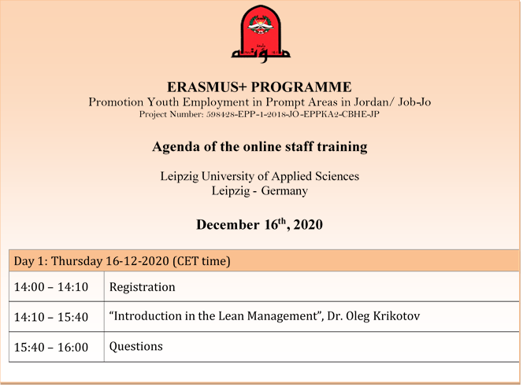
Work Package 2
Online Training at the Leipzig University of Applied Sciences 2020
9

Slide 10
Work Package 2
Activities |  | Start | End | Responsible & description | Comment
leader | Title
WP2 HTWK | 2.3 Training to study of the experience of European | 27.6.22 | 01.07.22 | HTWK, INT@E
Students of each partner from Jordan had a training at the HTWK and INT@E. Partners of HTWK and Int@E shared their experience about Vocational Educational Training (VET). The training focused on issues:
- Personal and Communication Skills;
- Job hunting and interview skills;
- Critical Thinking in Solving Problems;
- Opportunity to participate in Industry Awareness Experiences.
10

Slide 11
Work Package 2
Trainings at the HTWK 2019-2022
11

Slide 12
Work Package 2
HTWK participated (Dr. Oleg Krikotov) in the 7th Management Meeting at the UCY (August 4-6, 2021).
The BSNB networking Model has been presented and discussed with the project partners, recommendations for the Model improvement have been elaborated:
1. The EU approach
2. German experience/ examples
3. Recommendations – networking model, roles of stakeholders, new trends
12

Slide 13
Networking model BSNB
HTWK participated in the 8th Management Meeting at the INT@E (February 20-21, 2022).
The extended version of the BSNB networking Model has been presented.
13

Slide 14
Networking model BSNB
BSNB Online Monitoring, HTWK + ISLA (Monitoring Checklist).
07.06.2022 - 09.06.2022.
https://bbb.htwk-leipzig.de/b/kri-lm6-7uy-q5k
14

Slide 15
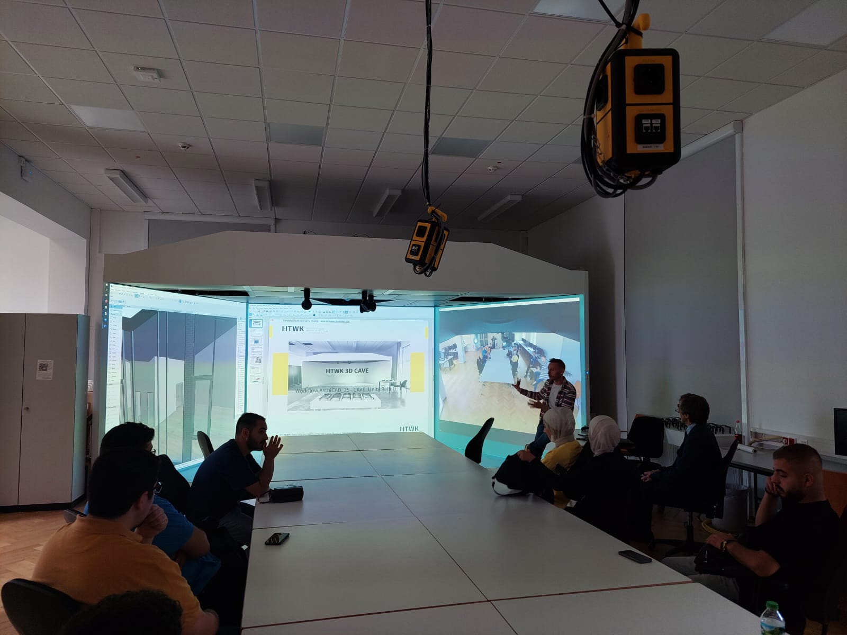
Work Package 2
Training for Students at the Leipzig University of Applied Sciences 2022
ERASMUS+ PROGRAMME
Promoting Youth Employment in Prompt Areas in Jordan/ Job-Jo
Project Number: 598428-EPP-1-2018-JO-EPPKA2-CBHE-JP
Students’ Training Agenda
HTWK
Leipzig-Germany
Gustav-Freytag-Str. 43 - 45, 04277 Leipzig
June 27th - 1st July 2022
15

Slide 16
Work Package 2
Day 1: Monday 27-06-2022 Session (1): Chaired by Prof. Dr.-Ing. Yaarob Al Ghanem
10:00 – 10:30 | Registration | Room T_A1.27
10:30 – 10:45 | Welcome speech and Training Introduction | Room T_A1.27
10:45 – 11:00 | Hygiene – Concept HTWK | Room T_A1.27
11:00 – 12:00 | Presentation of Professor Dr.-Ing. Yaarob Al Ghanem “Management on the construction site (watertight concrete structures)” | Room T_A1.27
12:00 – 12:15 | Questions and answers | Room T_A1.27
12:15 – 13:15 | Lunch
13:15 – 14:15 | Presentation of Professor Dr. Prof. h.c. mult. Klaus Hänßgen “Presentation of the Leipzig university of applied sciences HTWK Leipzig” | Room T_A1.27
14:15 – 14:30 | Questions and answers | Room T_A1.27
14:30 – 15:45 | Presentation of Dr. Krikotov: Introduction to the Lean Management | Room T_A1.27
15:45 – 16:00 | Questions and answers | Room T_A1.27
16

Slide 17
Work Package 2
Day 2: Tuesday 28-06-2022 Session (2): Chaired by Prof. Dr.-Ing. Yaarob Al Ghanem
10:00 – 11:30 | Presentation of Dr. Krikotov: Personal and Communication skills | Room T_A1.27
11:30 – 12:00 | Questions and answers | Room T_A1.27
12:00 – 13:00 | Lunch
13:00 – 14:30 | Presentation of Dr. Krikotov: Job preparation and Career development | Room T_A1.27
14:30 – 15:00 | Questions and answers | Room T_A1.27
15:00 – 15:15 | Hygiene – Concept Leipzig Job Center (Arbeitsamt) | Room T_A1.27
17

Slide 18
Work Package 2
Day 3: Wednesday 29-06-2022 Session (3): Chaired by Prof. Dr.-Ing. Yaarob Al Ghanem
10:00 – 11:30 | Presentation of Mrs. Ivanova: students’ start-up | Room T_A1.27
11:30 – 11:45 | Questions and answers | Room T_A1.27
11:45 – 12:00 | Hygiene – Concept company LeFx | Room T_A1.27
12:00 – 13:00 | Lunch
13:00 – 15:30 | Visit to the Leipzig Job Center (Arbeitsamt) | Georg-Schumann-Strasse 150, Leipzig
15:30 – 16:00 | Questions and answers | Georg-Schumann-Strasse 150, Leipzig
18

Slide 19
Work Package 2
Day 4: Thursday 30-06-2022 Session (2): Chaired by Prof. Dr.-Ing. Yaarob Al Ghanem
10:00 – 12:00 | Visit to the Students start-up company LeFx | August-Bebelstrasse 14, Leipzig
12:00 – 13:00 | Lunch
13:00 – 14:30 | Presentation of Ms. Flach, HTWK Department of Academic Affairs: consulting of international students about internships, part-time jobs and starting a career after graduation | Room T_A1.27
14:30 – 14:45 | Questions and answers | Room T_A1.27
14:45 – 16:15 | Presentation of Dr. Krikotov: Critical Thinking | Room T_A1.27
16:15 – 16:30 | Questions and answers | Room T_A1.27
19

Slide 20
Work Package 2
Day 5: Friday 01-07-2022 Session (3): Chaired by Prof. Dr.-Ing. Yaarob Al Ghanem
10:00 – 12:00 | Studio-Tour MDR (Mitteldeutscher Rundfunk) | Kantstrasse 71 - 73, Leipzig
12:00 – 13:00 | Visit to the HTWK digital laboratory “Cave” M.Sc. Alex Dekin | Room T_A1.27
13:00 – 14:30 | Final discussion, summary of the training session | Room T_A1.27
14:30 – 15:00 | Certificates awarding ceremony | Room T_A1.27
20

Slide 21
Many thanks for your
kind attention.
21

